Slide 1
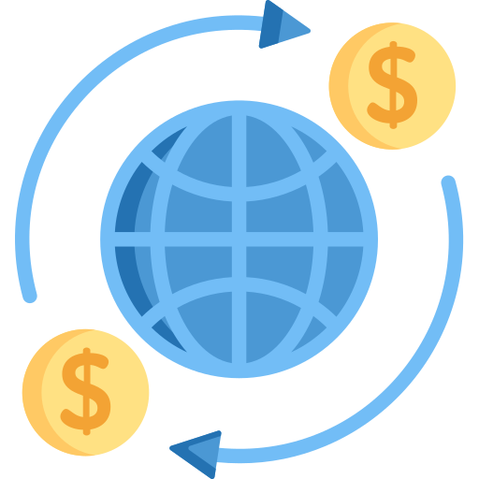

Ai Enabled Fintech B2B Invoice Management Application
Riya Rani Manal - 1906493
B2B

Slide 2

Introduction
B2B stands for business-to-business. Businesses work on a credit basis with one another. When a buyer company orders products from a seller company, the seller company sends an invoice to the buyer company. This products invoice includes information such as the details of the goods purchased and when they should be paid. The buyer company must pay the balance due before the deadline. In real-world settings, however, invoices are not always cleared, that is, paid in full by the due date (The payment date is the date on which a client clears the payment for an invoice.) The project is split into two sections. A Machine Learning Model is created in the first phase of this project to predicted the payment date. In the second half of the project a full stack InvoiceManagement Application is built using ReactJs, JDBC, Java and JSP. In this application a responsive Receivables Dashboard is built. Here we can visualize the Data in the form of grids , perform searching operations on the invoices , modify data in the editable fields of the grid and download data of selected rows in predefined templates.
B2B

Slide 3
Problem Description
Build a full stack B2B Management Application which will store, read, edit, delete & predict the invoices & manage them
The problem statement is divided into three parts:
First part is to build a machine learning model which will predict the return date when provided with the initial date & convert it to REST Api using Flask
Second part is to build Server using Java-Servlet & make it a REST-Api
Third part is to build web-app using ReactJs & connect it to REST Service
B2B

Slide 4
~ ML Model & Prediction API
B2B

Slide 5
Steps
Importing necessary libraries: Importing libraries like pandas, numpy, matplotlib,sea born, sklearn, xgboost, pickle.
Data Cleaning: Dropping unnecessary columns and rows containg null values
Feature Engineering: The "business_code" column inside X_train, is a categorical column, so we performed Labelencoder on that particular column & stored the value "business_code_enc"
Outlier detection & removal: Detecting extreme cases and removing them.
Model building: Training our model using Xgboost and testing using test data.
B2B

Slide 6
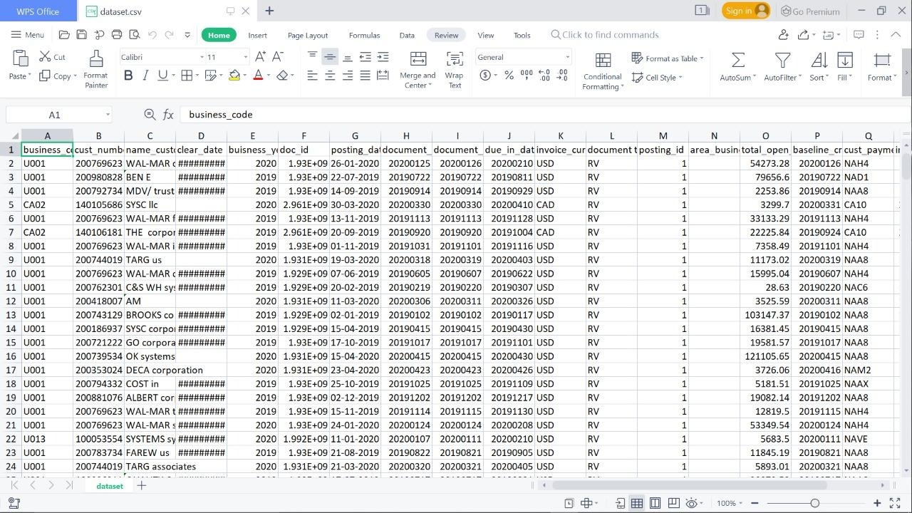
Dataset
The dataset contains 50k rows and 19 columns
B2B

Slide 7
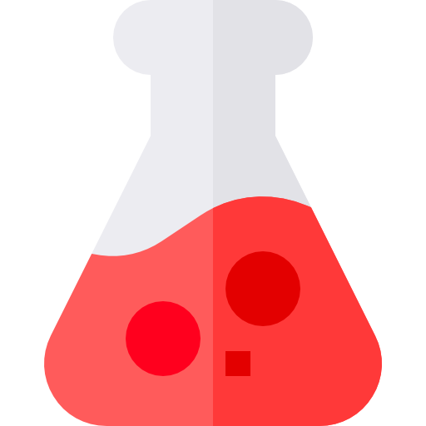
Flask Api
Flask is a popular micro framework for building web applications. Since it is a micro-framework it is easy to use
Here, the instance of the trained ml-model is extracted using “pickle” & converted to REST-Api using “Flask”
B2B

Slide 8
~ Server Side
B2B

Slide 9
Steps
Importing jars: javax, jakarta,jersey,gson, servlet-api, mysql- connector
JDBC : Connecting server to MySql DB
Servlet : Creating http end points for CRUD operation
Annotations : using annotation to hook the end-points.
Headless CMS : Making the java servlets stand alone to make Rest Api.
B2B

Slide 10
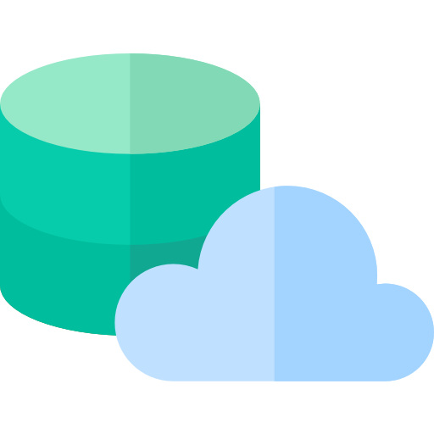
JDBC
The Server needs to be connected to MySQL DB which needs a plugin “mysql-connector/Java”
→ We have created a separate class for JDBC to make use of it multiple times
→ This helps in optimization of the server & its latency period
B2B
Bioscope

Slide 11

Servlet
Server needs to have end-points which are hooked to using annotations :
getInvoiceData (GET) : it throws back invoices of all customers
addInvoiceData (POST) : it adds invoice the mysql DB
deleteInvoiceData (DELETE) : it removes invoice by “id” from mysql DB
editInvoiceData (PATCH) : it edits invoice the mysql DB by “id”
advancedSearchInvoiceData (GET) : it returns invoice from the mysql DB by multiple parameters
B2B

Slide 12

Annotations
Server always has end-points & it can be hooked using either the xml or annotations
Here annotations has been used to hook up the end-points to the servlets :
End-points :
→ create
→ fetch
→ update
→ delete
→ prediction
→ search
B2B
Bioscope

Slide 13

Headless CMS
Server has servlets & it has been created as stand-alone CMS to make a REST-Api
So that it does not depend upon the client-side for & irrespective of the client-side it maintains its state & stability.
Basically it does not depend upon the client-side
B2B
Bioscope

Slide 14
~ Client Side
B2B

Slide 15
Steps
Importing libraries : axios, mui, formik, react-bootstrap, yup, mui-data-grid, date-fns, chart.js
Layouts : Creating dashboard & tables
Data Link : Connecting to REST Service using axios & storing the information in optimized manner
Resolving Prop-Drilling : Making the states global using Context-Api & passing to its children
Using Component LifeCycle : useEffect() has been used to detect & render the changes on the Web-App
Testing & Deployment : React code was tested using JEST & deployed on Netlify using Github pipelining
B2B

Slide 16

Data Link Layer
Firstly the Web-App is connected to REST Service using “Axios” & the data fetched is stored in states in optimize manner :
getInvoiceData (GET) : it throws back invoices of all customers
addInvoiceData (POST) : it adds invoice the mysql DB
deleteInvoiceData (DELETE) : it removes invoice by “id” from mysql DB
editInvoiceData (PATCH) : it edits invoice the mysql DB by “id”
advancedSearchInvoiceData (GET) : it returns invoice from the mysql DB by multiple parameters
B2B

Slide 17

Layouts
The concept of library & framework of JS is dependent upon components. Its made to make our life easy & reuse as many times we want. Here we made 3 components :
Dashboard - used for rendering the ashboar feature that shows the statictics of the managenment application
Table - for rendering data-grid of the invoices
B2B

Slide 18

Resolving Prop-Drilling
Prop drilling is a situation where data is passed from one component through multiple interdependent components until we get to the component where the data is needed It makes the application slower, reduces efficiency & increases latency. Which needs to be removed for better performance
→ We have resolved the prop drilling by using ‘’Context-Api” which makes the states global, making the state reachable from anywhere on the tree
B2B
Bioscope

Slide 19

Component Life-Cycle
Each component in React has a lifecycle which we can monitor and manipulate during its three main phases
The three phases are: Mounting, Updating, and Unmounting In this project lifecycle of each component has its trigger depenency :
Read Data - start of web-app
B2B

Slide 20
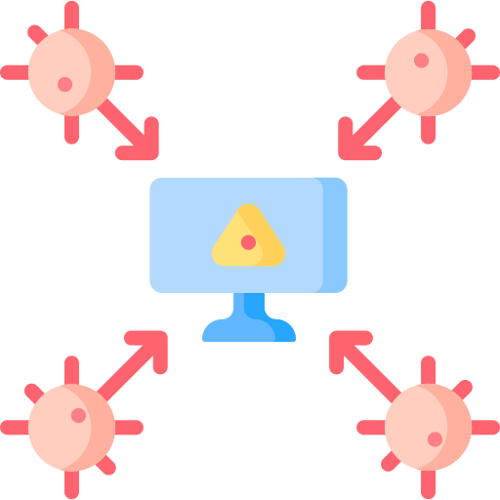
Testing & Hosting
Testing is integral part of software development. Hosting cannot be done without testing
→ Testing in React : Unit tests, Integration tests, end-to-end tests. Unit test is single test of code isolation.
→ Hosting : After testing the web-app is hosted on “Netlify” & pipelined to “Github” so that any changes pushed to the repository will automatically deploy the changes on the Internet
B2B
Bioscope

Slide 21
~ Final Product
B2B

Slide 22
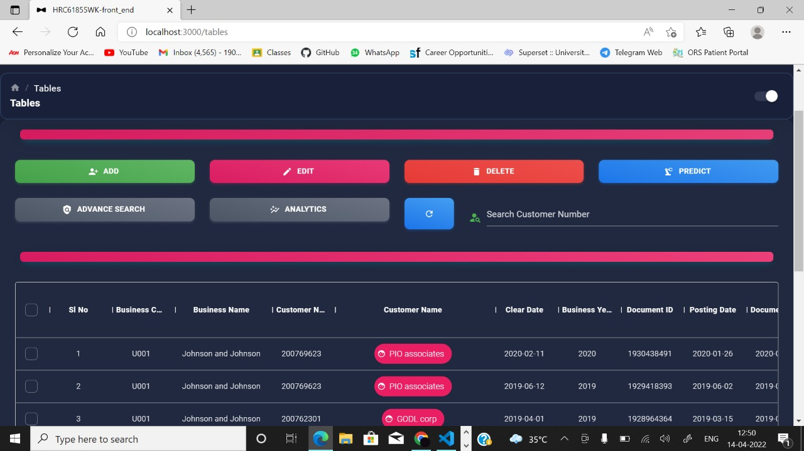
B2B

Slide 23
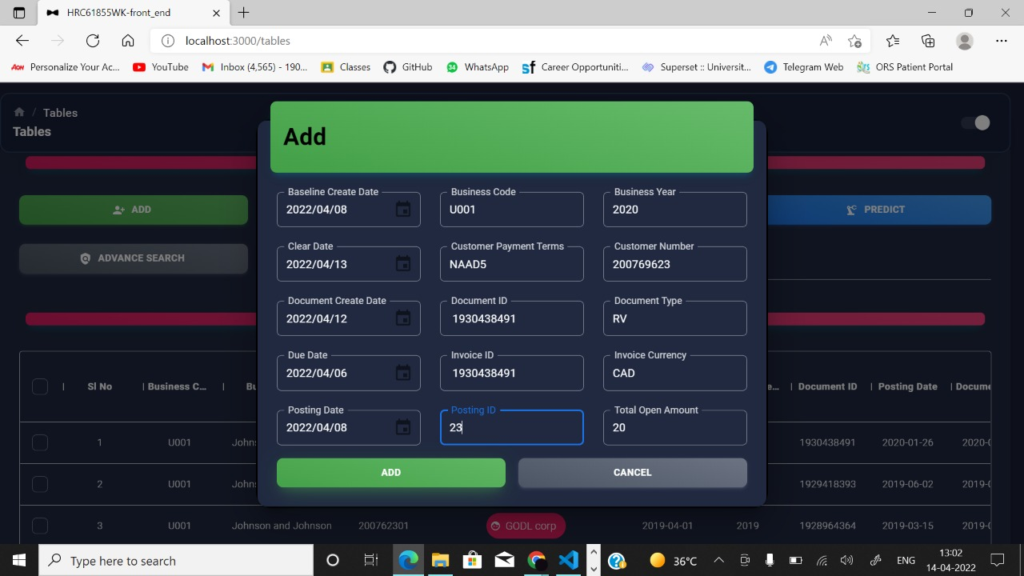
B2B

Slide 24
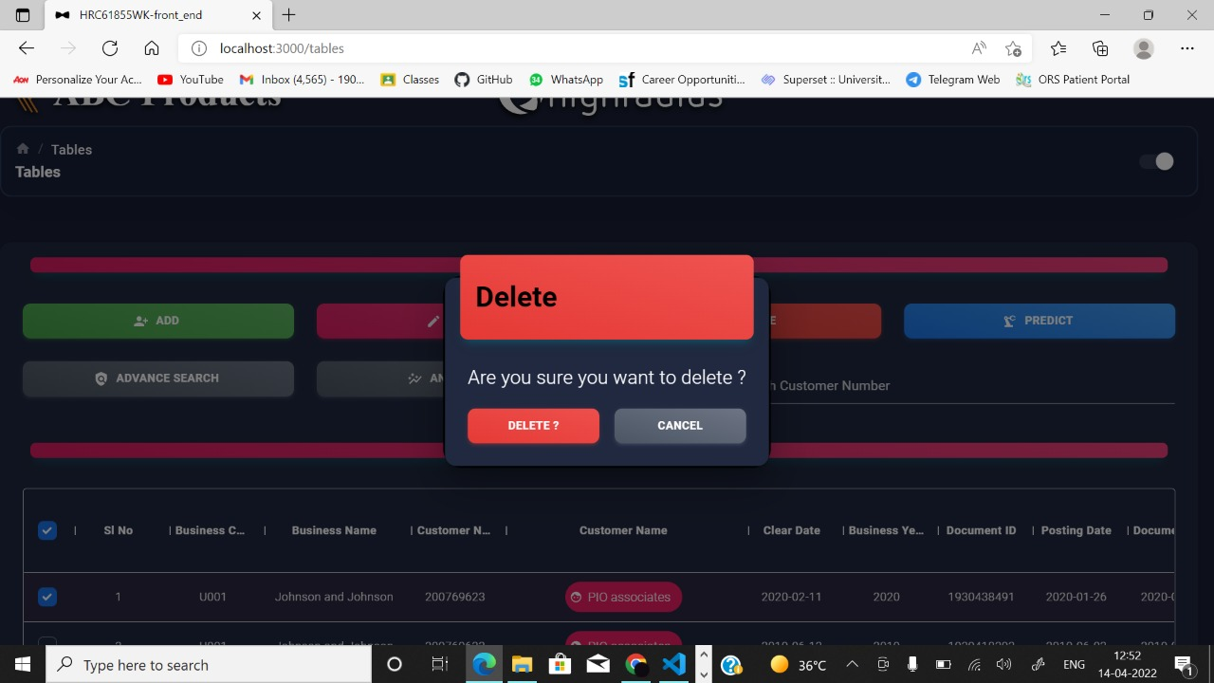
B2B

Slide 25
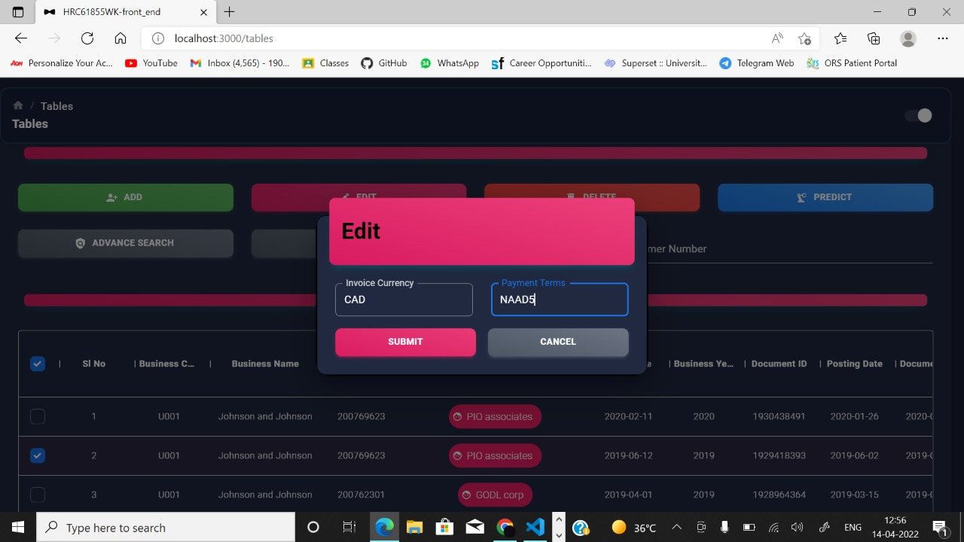
B2B

Slide 26
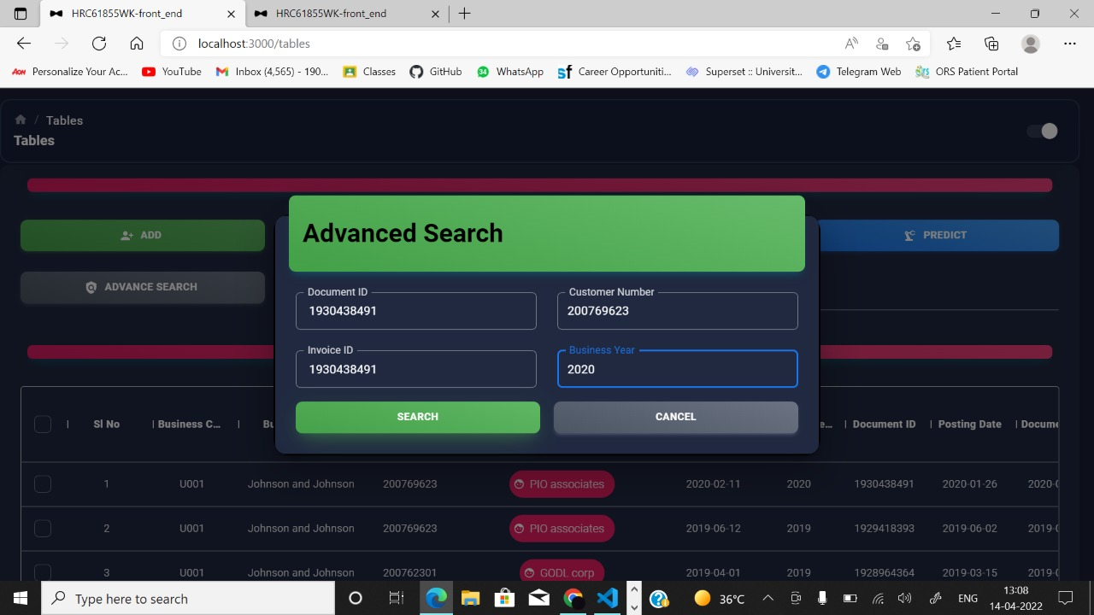
B2B

Slide 27
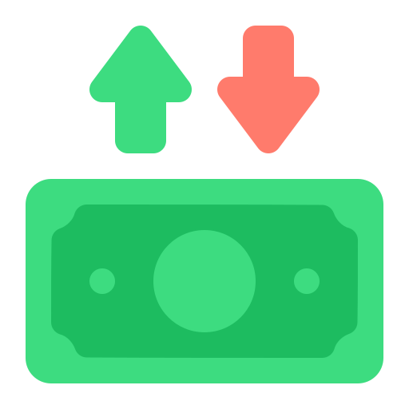
Conclusion
The project's major goal is to handle the Account Receivable department in a simple, seamless, and efficient manner. Account managers will be able to collect payments for past due invoices from consumers. They might send consumers reminders and follow-ups to ensure that payments are made on time. They may handle the full process of obtaining cash inflow as well as assisting the company in receiving payment for the services and products provided. Any tool or platform that controls sales, orders, inventory, and fulfilment, as well as the people, procedures, and partnerships required for products to reach the customers who purchased them, is known as an order management system.In this project, I have built an AI-Enabled Fin Tech B2B Order Management Application using regression model to predict payment of order will be delayed or not. The root mean square errorof the model turned out to be 6.73. The same has been then deployed using Flask Framework and React JS for front end.
B2B

Slide 28

TV FEATURES:-fgjfjfjfjjf
THANK YOU !!!
B2B

